Slide 1
Laserck CAD software
MARK V
www.laserck.com

Slide 2
. . . Import the printing side layout data
www.laserck.com

Slide 3
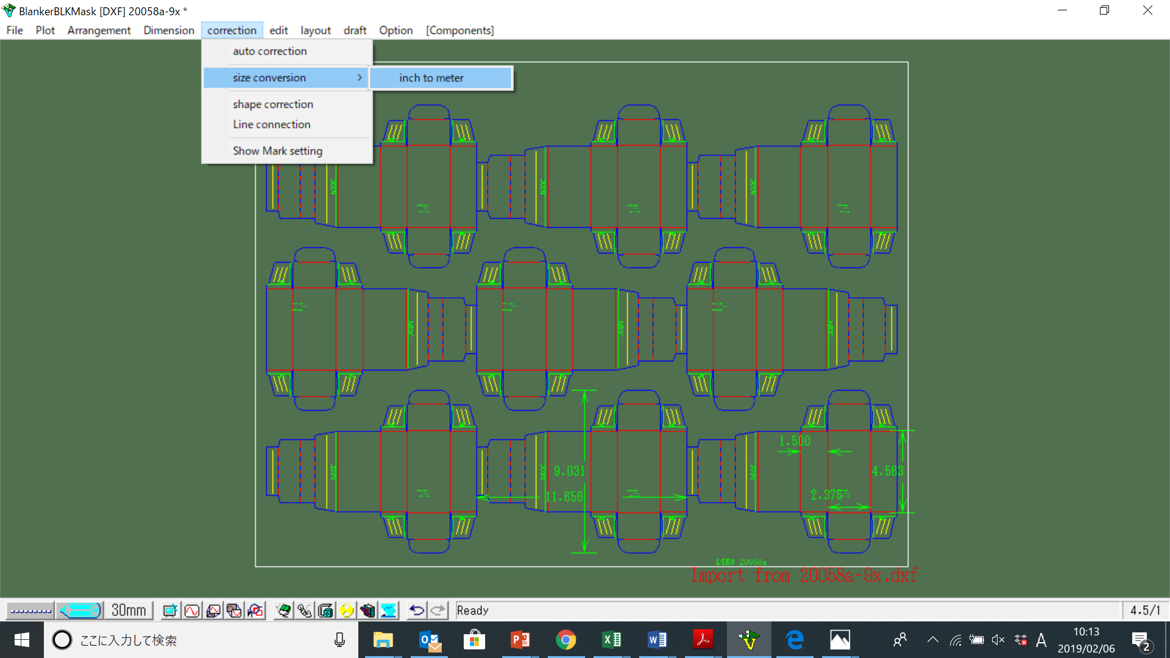
. . . Size conversion
www.laserck.com

Slide 4
. . . Pin display
www.laserck.com

